Slide 1
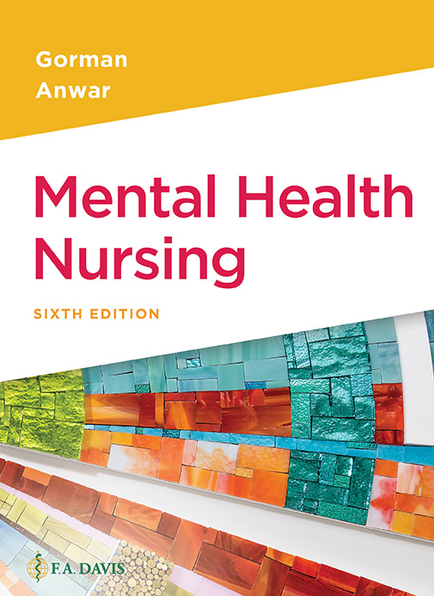
Book cover for Mental Health Nursing, Sixth Edition.
Chapter 13
Suicide

Slide 2
Learning Outcomes
Identify main populations at risk for suicide.
Identify myths and truths about suicide.
Identify warning signs of suicide.
Identify nursing care for people who are suicidal.
Describe the management of a suicidal patient in the acute hospital.

Slide 3
Suicide
Suicide is the act of taking one’s own life voluntarily and intentionally (Merriam-Webster.com)
Civil rights/right-to-choose issue
Medical/ethical issue
Generally, suicide is viewed very negatively in our society

Slide 4
Suicide Facts
12th leading cause of death in the United States
2nd leading cause of death among adolescents and young adults
More people die from suicide than homicide
Ratio of attempts at suicide to completed suicide is at least 12:1

Slide 5
More Facts
Thinking about suicide does not mean the individual will act on those thoughts; however, anyone who talks about, threatens, or makes a suicide attempt must be taken seriously
Substance abuse is a major risk factor

Slide 6
Clicker Question
Which person is at highest risk for suicide?
Teenager breaking up with girlfriend
Young mother whose child is very ill
White male with long history of alcohol abuse
55-year-old married woman with pancreatic cancer
Notes:
Correct Answer: C
Rationale: Substance abuse is a strong contributor to suicidal behavior.

Slide 7
Causes
Depressive disorder and substance abuse disorders are the primary risk factors
Other psychiatric disorders including anxiety, bipolar, psychosis
Suicide pacts (especially among teenagers), copycat suicides (also young people)

Slide 8
Contributors to Suicide
Hopelessness
Shame
Guilt
Humiliation
Isolation

Slide 9
Clicker Question (continued_1)
Which question is least crucial in assessing suicide risk?
Have you ever thought about suicide?
Do you have a plan to commit suicide?
How many children do you have?
Who makes up your support system?
Notes:
Correct Answer: C
Rationale: Better to ask who the patient has as a support system rather than how many children. Number of children is no indicator of current support network.

Slide 10
Methods
The most common methods of suicide include firearms, hanging, and overdose.
Men tend to use firearms and hanging, leading to higher death rate. Women are more likely to use overdose.

Slide 11
Warning Signs
Verbal threats
Expressions of hopelessness
Prior suicide attempts
Risk-taking behaviors
Talking about suicide
Access to lethal methods

Slide 12
Symptoms
Gives personal items away
“Cleaning house”
Wants a “special friend” to have a particular item
Person starts talking about death or becomes preoccupied with learning about death
Sudden improvement in mood from previous depressed mood
Person has difficulty sleeping or maintaining healthy sleep pattern

Slide 13
Treatment
Emergency psychiatric care
Treatment of depression, psychosis, bipolar, substance abuse
Suicide hotlines
Most people who think about suicide are ambivalent so they may drop hints to be rescued
Patient along with family and friends have a safety plan to identify who to call for help

Slide 14
Nursing Interventions
Anyone who threatens or talks about suicide must be taken seriously
Honest, confrontational communication
“Are you planning to kill yourself?” “How?” “When?” etc.
Monitor—usually every 10–15 minutes in hospital or facility
Identify means to complete self-harm and remove those if possible

Slide 15
Nursing Interventions (continued)
Maintain safety (for patient, yourself, and others)
In a facility, institute suicide precautions
Remove all potential weapons (knives, silverware, pens, glass bottles, bed linens, electrical cords, etc.)
Medications
Be certain the patient has swallowed their medications and is not “pouching” or saving them

Slide 16
Clicker Question (continued_2)
Which of the following should be part of suicide precautions in a facility?
Allow frequent unsupervised visits for support
Move patient close to nursing station
Notify all staff of patient suicide risk
All of the above
B and C
Notes:
Correct Answer: E
Rationale: Close monitoring of the patient can be improved when all staff are aware of risk and patient is moved closer to nursing station. Visitors may need to be screened as they could knowingly or unknowingly provide suicide means to this patient.

Slide 17
Family Survivors
When someone commits suicide, the loved ones left behind are at high risk for long-term distress due to guilt and anger about the suicide

